Slide 1


Justin Fernandes
7/8/2024

Slide 2

Outline
Executive Summary
Introduction
Methodology
Results
Conclusion
Appendix

Slide 3
Executive Summary
The Space Race of the past can be utilized to determine which factors play an important role in the success rate of launches. From the research, it was determined that the success rate increased over time, and varied based on different factors, like distance of travel, launch location, and booster versions. This was done utilizing data visualization, data analysis, and standardization.

Slide 4
Introduction
The main question that we intend to answer is:
What factors play the most role in the success rate of a launch and mission.
In doing so, we can nearly guarantee the success rate of a launch, providing a safer, cheaper, and easier pathway towards better space travel

Slide 5

Section 1

Slide 6
Methodology
Executive Summary
Data collection methodology:
Describe how data was collected
Perform data wrangling
Describe how data was processed
Perform exploratory data analysis (EDA) using visualization and SQL
Perform interactive visual analytics using Folium and Plotly Dash
Perform predictive analysis using classification models
How to build, tune, evaluate classification models

Slide 7
Data Collection
Data was collected in two basic ways, web scraping and basic inputs. For basic inputs, we utilized User Defined Functions to take the data from the source and convert it into a data frame. With web scraping, we did the same thing but used Beautiful Soup to obtain the data.

Slide 8
Data Collection – SpaceX API
IBM-Data-Science-Final/jupyter-labs-spacex-data-collection-api.ipynb at main · Just1nFernandes/IBM-Data-Science-Final (github.com)
Obtain Source -> Standardize Data -> Remove Clutter -> Input into Table -> Clean up non-values

Slide 9
Data Collection - Scraping
IBM-Data-Science-Final/jupyter-labs-webscraping.ipynb at main · Just1nFernandes/IBM-Data-Science-Final (github.com)
Create Soup -> Pull Table -> Create Data Frame -> Insert Table into Data Frame

Slide 10
Data Wrangling
Data was wrangled by adding a “Class” column, which determined if the missions were successful or not based on the outcome. If the mission outcome was a “Bad Outcome”, it would be a failure and given a class of 0, if it was not a bad outcome, it would be given a value of 1
IBM-Data-Science-Final/labs-jupyter-spacex-Data wrangling.ipynb at main · Just1nFernandes/IBM-Data-Science-Final (github.com)

Slide 11
EDA with Data Visualization
Data was visualized with multiple different graphs, including bar charts, line charts, and scatter plots
IBM-Data-Science-Final/edadataviz.ipynb at main · Just1nFernandes/IBM-Data-Science-Final (github.com)

Slide 12
EDA with SQL
Using SQL we found
The launch sites
The records with CCA
Total and average payload mass
Earliest success date
Booster that worked
Successful and failed mission outcomes
All the max boosters
IBM-Data-Science-Final/jupyter-labs-eda-sql-coursera_sqllite.ipynb at main · Just1nFernandes/IBM-Data-Science-Final (github.com)

Slide 13
Build an Interactive Map with Folium
The interactive maps had markers with launch sites, successes and failures, and distances with launch sites
IBM-Data-Science-Final/lab_jupyter_launch_site_location.ipynb at main · Just1nFernandes/IBM-Data-Science-Final (github.com)

Slide 14
Build a Dashboard with Plotly Dash
The dashboard had interactive charts that would enable users to visualize the data better

Slide 15
Predictive Analysis (Classification)
Using machine learning, we were able to standardize, train, and test it. In doing this ,we found the most accurate was K Nearest Neighbors and SVM, and the least accurate was decision tree.
IBM-Data-Science-Final/SpaceX_Machine Learning Prediction_Part_5.ipynb at main · Just1nFernandes/IBM-Data-Science-Final (github.com)

Slide 16

Section 2

Slide 17
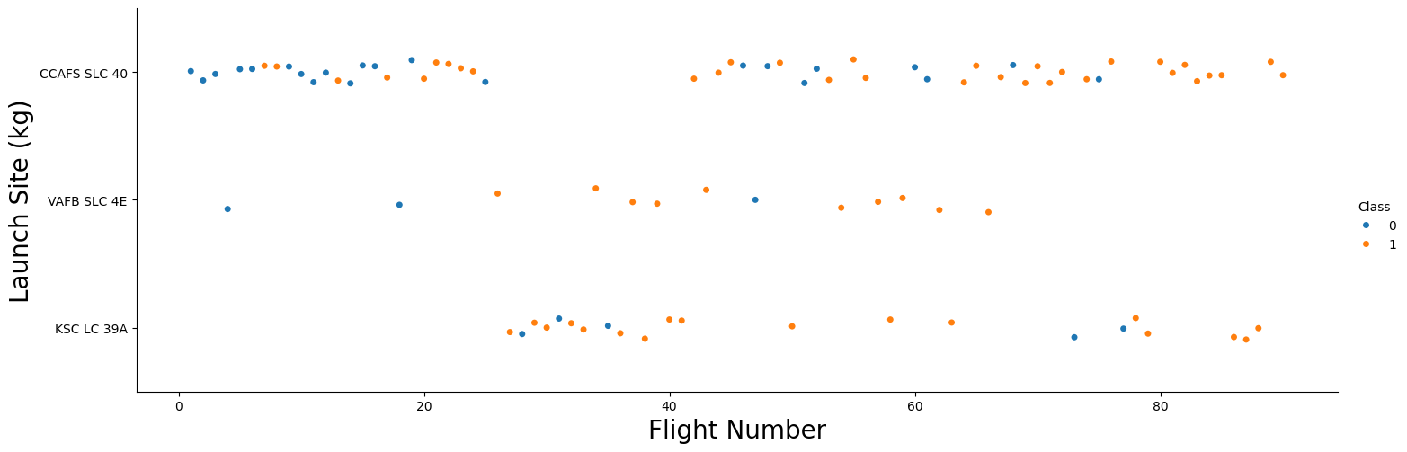
Flight Number vs. Launch Site

Slide 18
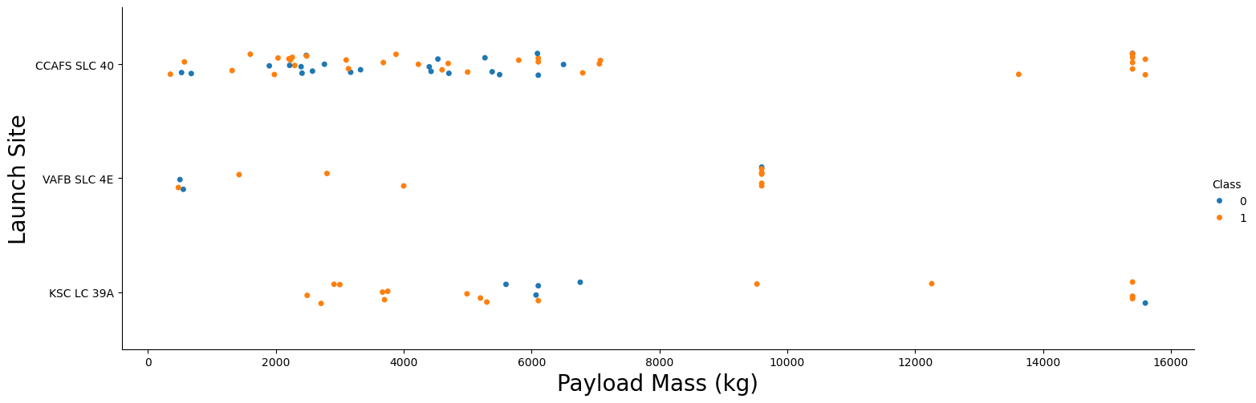
Payload vs. Launch Site

Slide 19
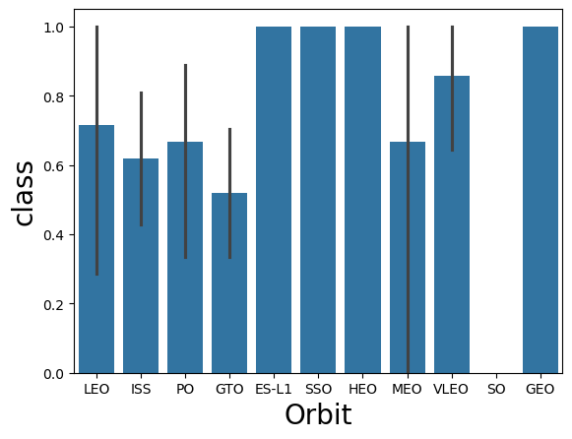
Success Rate vs. Orbit Type

Slide 20
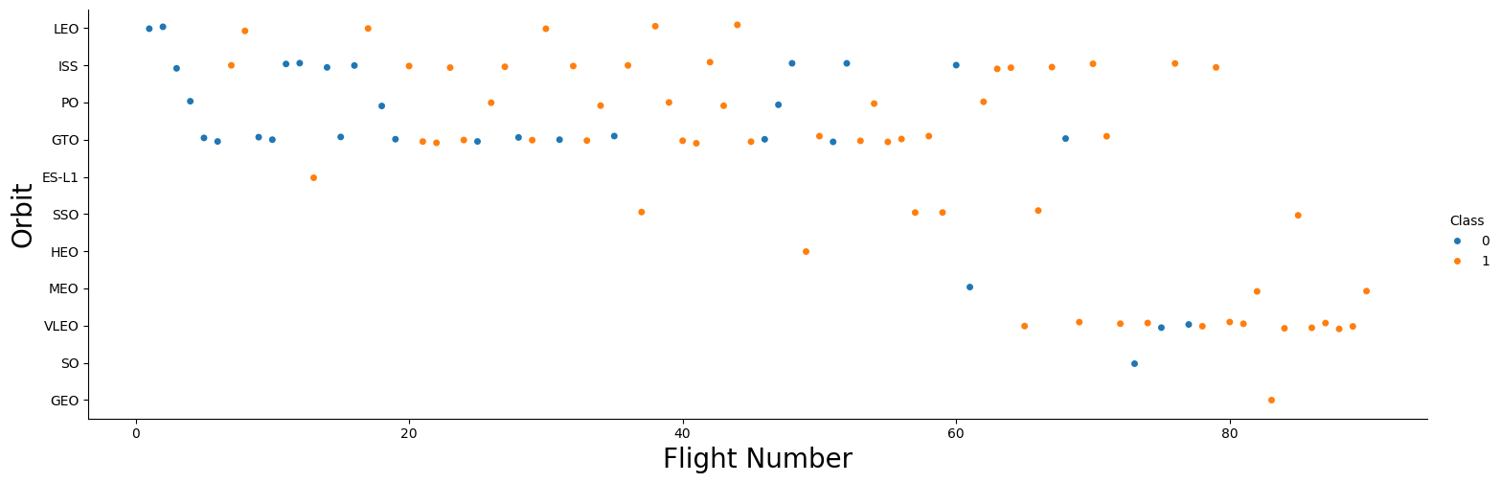
Flight Number vs. Orbit Type

Slide 21
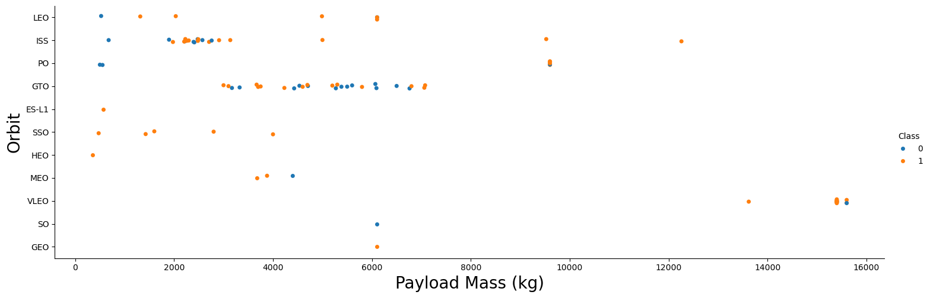
Payload vs. Orbit Type

Slide 22
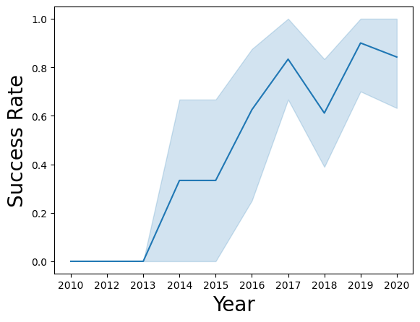
Launch Success Yearly Trend

Slide 23
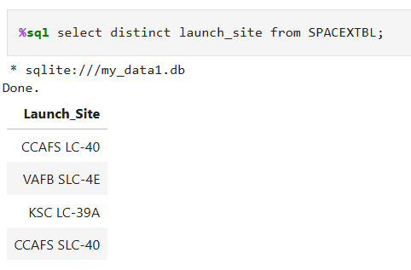
All Launch Site Names

Slide 24
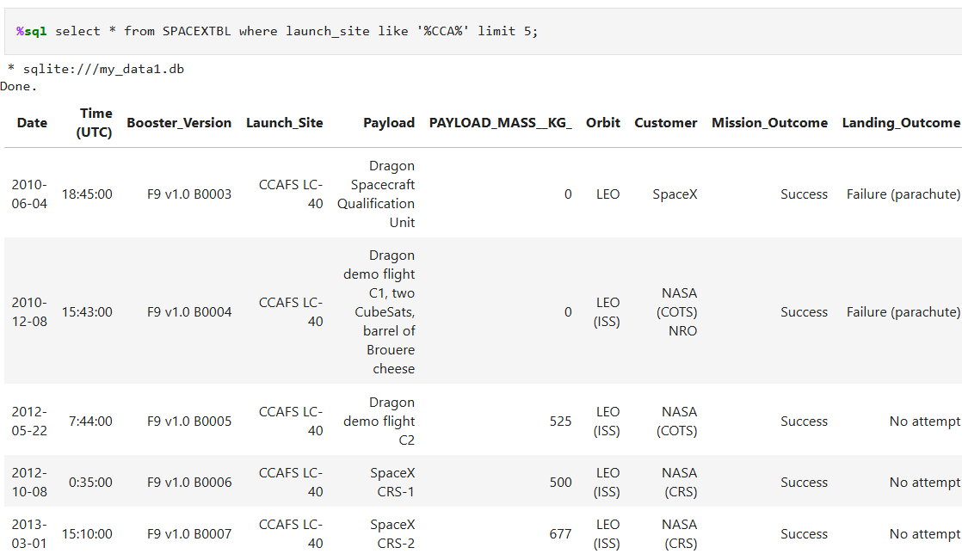
Launch Site Names Begin with 'CCA'

Slide 25
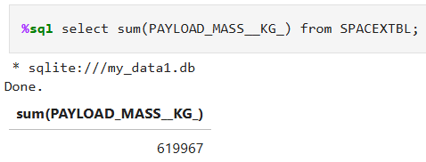
Total Payload Mass

Slide 26
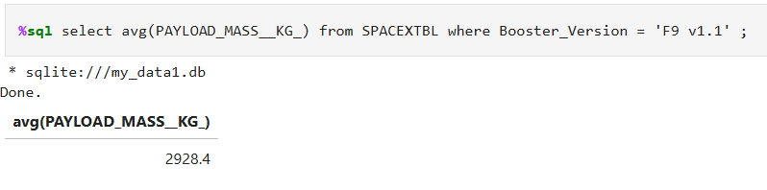
Average Payload Mass by F9 v1.1

Slide 27
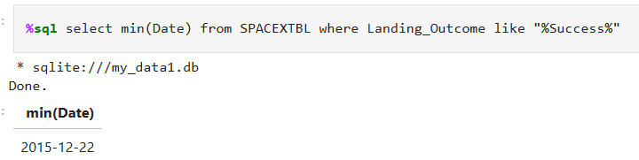
First Successful Ground Landing Date

Slide 28
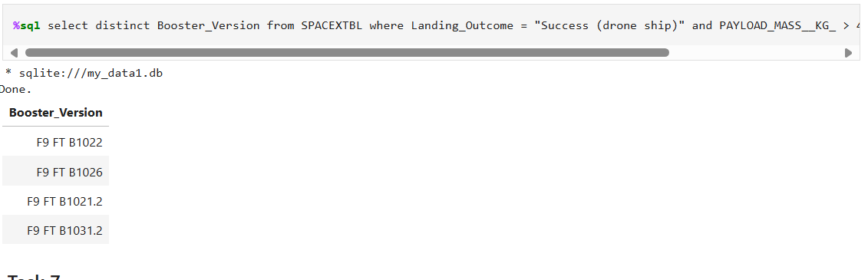
Successful Drone Ship Landing with Payload between 4000 and 6000

Slide 29
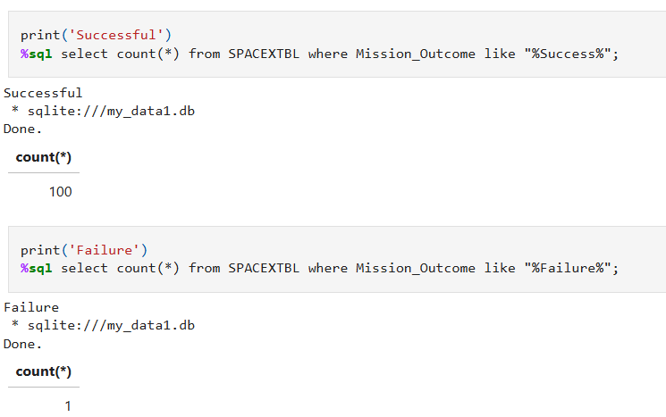
Total Number of Successful and Failure Mission Outcomes

Slide 30
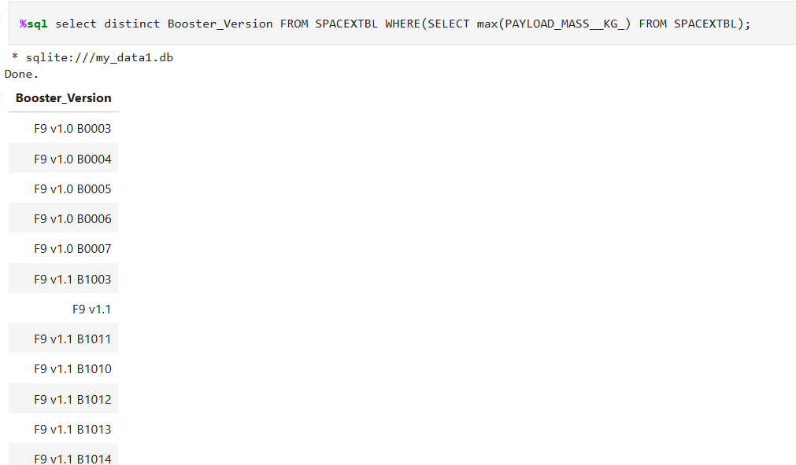
Boosters Carried Maximum Payload
Rest of Table was Cut off

Slide 31
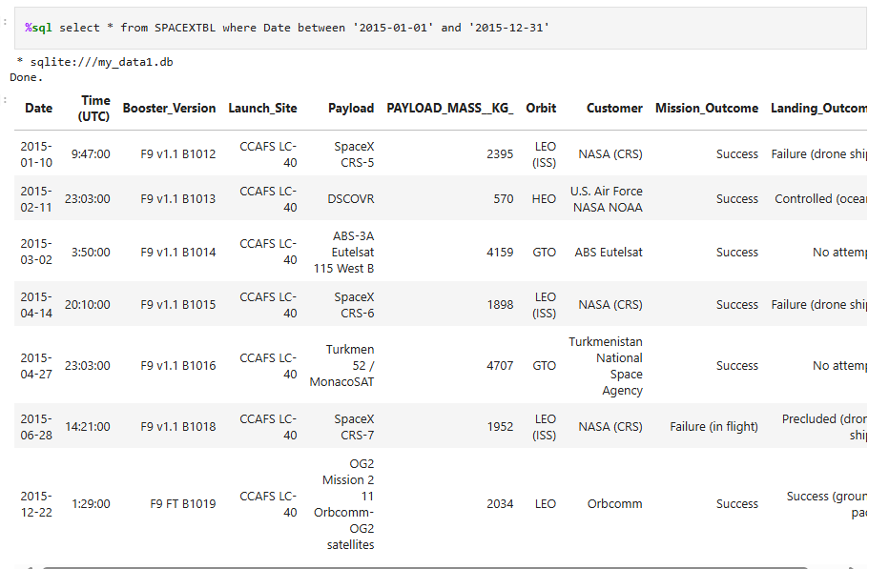
2015 Launch Records

Slide 32

Section 3

Slide 33
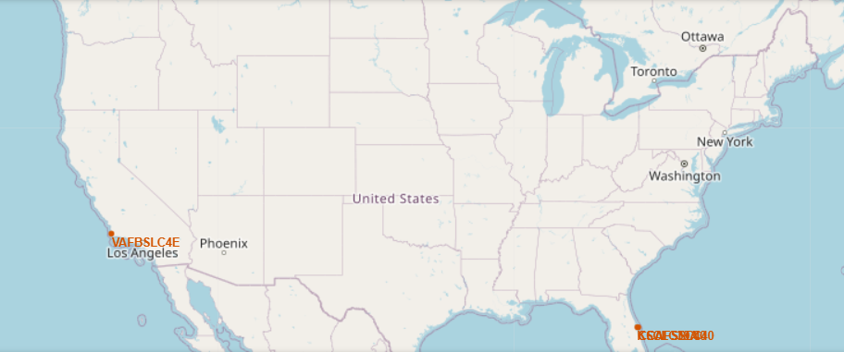
Launch Locations

Slide 34
<Folium Map Screenshot 2>
Replace <Folium map screenshot 2> title with an appropriate title
Explore the folium map and make a proper screenshot to show the color-labeled launch outcomes on the map
Explain the important elements and findings on the screenshot

Slide 35
<Folium Map Screenshot 3>
Replace <Folium map screenshot 3> title with an appropriate title
Explore the generated folium map and show the screenshot of a selected launch site to its proximities such as railway, highway, coastline, with distance calculated and displayed
Explain the important elements and findings on the screenshot

Slide 36

Section 4

Slide 37
<Dashboard Screenshot 1>
Replace <Dashboard screenshot 1> title with an appropriate title
Show the screenshot of launch success count for all sites, in a piechart
Explain the important elements and findings on the screenshot

Slide 38
<Dashboard Screenshot 2>
Replace <Dashboard screenshot 2> title with an appropriate title
Show the screenshot of the piechart for the launch site with highest launch success ratio
Explain the important elements and findings on the screenshot

Slide 39
<Dashboard Screenshot 3>
Replace <Dashboard screenshot 3> title with an appropriate title
Show screenshots of Payload vs. Launch Outcome scatter plot for all sites, with different payload selected in the range slider
Explain the important elements and findings on the screenshot, such as which payload range or booster version have the largest success rate, etc.

Slide 40

Section 5

Slide 41
Classification Accuracy
 | Accuracy | Test Accuracy
Logistic regression | 84.64 | 83.33
Support vector machine | 84.82 | 83.33
Decision tree classifier | 87.4 | 55.5
K nearest neighbors | 84.82 | 83.33

Slide 42

Confusion Matrix

Slide 43
Appendix
Just1nFernandes/IBM-Data-Science-Final (github.com)

Slide 44


